Slide 1
Group 2 PAI Presentation
Quah Johnnie (2007476), Wee Loon (2112802), Jayden (2112790)

Slide 2
Table of Contents
Sections | Remarks
Intro
Week 1-3 | User Stories, Backlog, User DB Design, SQL Scripts (Data import)
Week 4-5 | SQL Scripts (Complex Queries), Python EDA & ETL
Week 6-7 | Tableau Sheets & Dashboard Design
Summary

Slide 3
Introduction
Our objective here is to help a taxi company, Just Taxi, analyze their taxi data and provide insights as to what driving behaviours may lead to danger.

Slide 4
Week 1-3 Deliveriables
User Stories, Backlog, User DB Design, SQL Scripts (Data import)

Slide 5
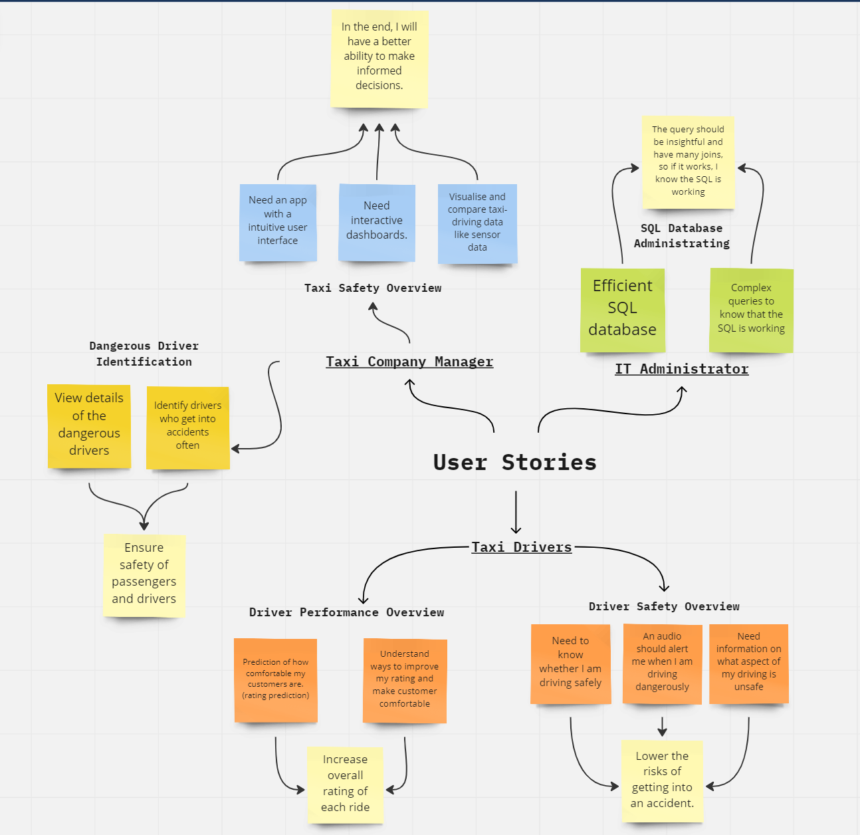
User Stories

Slide 6
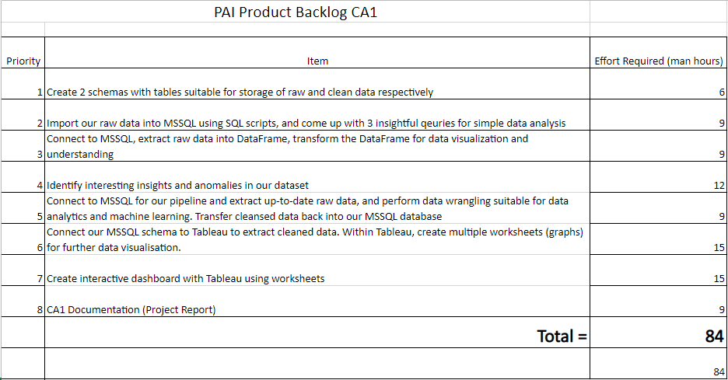
Backlog
Backlog Owner: Jayden
Sorted by priority
Man hours calculated by number of people * hours output per week * weeks left (3 * 4 * 7) = 84
Effort required decided by difficult and total man hours.

Slide 7
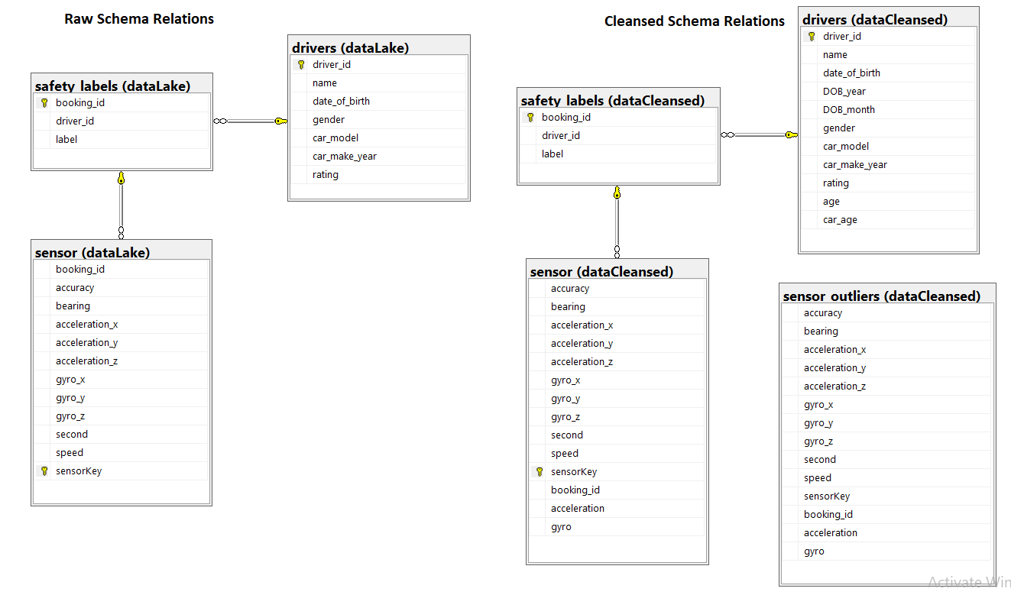
Database Design
SQL scripts were created to generate the following:
Database name Taxi_Trip
2 schemas named dataLake and dataCleansed.
3 tables were made, drivers, safety_labels and sensors.
Each column will initially be of ‘VARCHAR’ datatype.

Slide 8
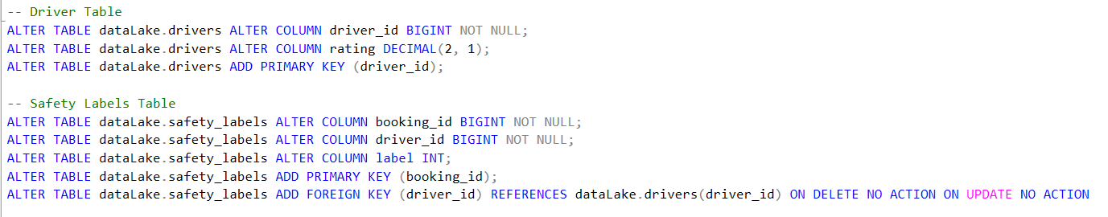
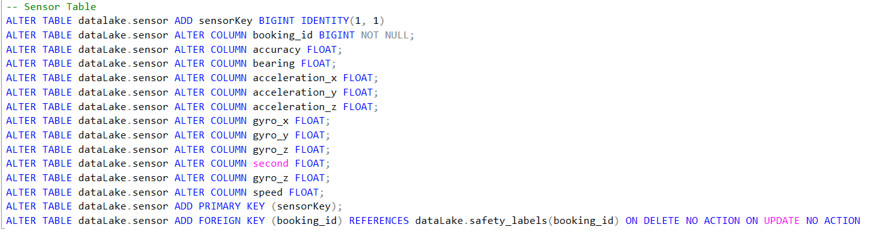
Importing Data & Creating Tables
Snippet of code to import data
Another SQL script was used to import the data from the .csv files.
After insertion of the records to the tables, the datatype is then manually changed, and relations are added in.
Snippet of code to alter tables with relation

Slide 9
Week 4-5 Deliveriables
SQL Scripts (Complex Queries), Python EDA & ETL

Slide 10
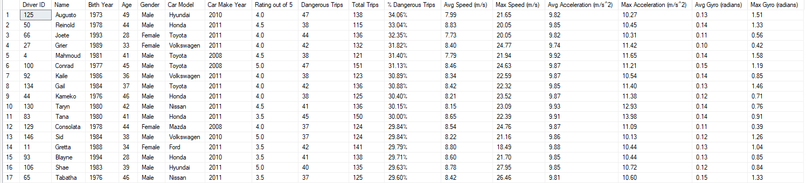
Complex Query 1
Display top dangerous drivers by percentage of dangerous labels
Sub-queries used to make sure our results are correct
Driver details shown: DriverID, Name, Birth Year, Age, Gender, Car Model, Car Make Year, Avg Rating, No of Dangerous Trips, No of Total Trips, % of Dangrous Trips.
Car details shown: Avg Speed, Max Speed, Avg Acceleration, Max Acceleration, Avg Gyro, Max Gyro.

Slide 11
Complex Query 2
Details related to Safe and Dangerous labels
Sub-queries used to make sure our results are correct
Label details shown: Count of Safe/Dangerous
Car details shown: Avg Speed, Max Speed, Avg Acceleration, Avg Acceleration (x,y,z), Max Acceleration, Avg Rating, Avg Gyro, Avg Gyro (x,y,z), Max Gyro

Slide 12
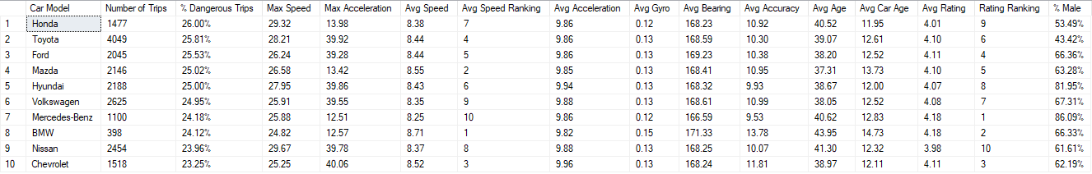
Complex Query 3
Details related to different Car Models
Sub-queries used to make sure our results are correct
Label details shown: Number of Trips, % of Dangerous Trips
Car details shown: Max Speed, Max Acceleration, Avg Speed, Avg Speed Ranking, Max Acceleration, Avg Speed, Avg Speed Ranking, Avg Gyro, Avg Bearing, Avg Accuracy
Driver details shown: Avg Age, Avg Car Age, Avg Rating, Rating Ranking.
Car ownership details shown: % Of Males

Slide 13
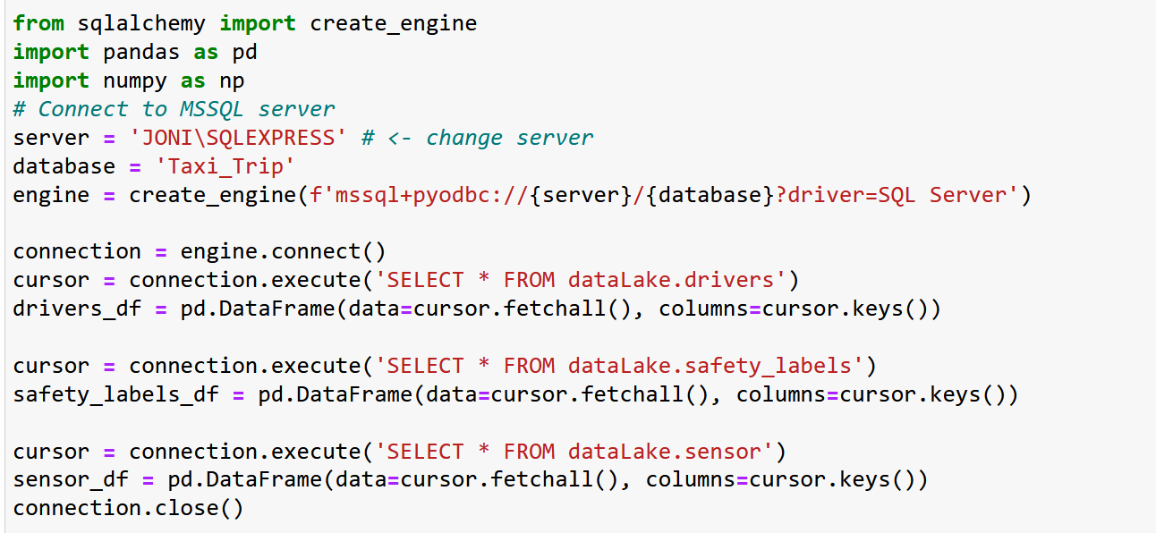
ETL – Extract
Used SQLALCHEMY library to extract the raw data from different tables

Slide 14
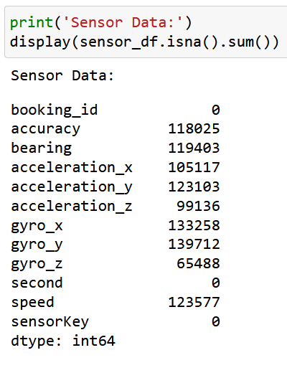
ETL – Data Imputation
Missing data seen in most columns
Accuracy is dropped and Iterative Imputation using LinearRegression is used to impute our missing data.
Accuracy is not imputed as it does not make sense to fill in a predicted accuracy.

Slide 15
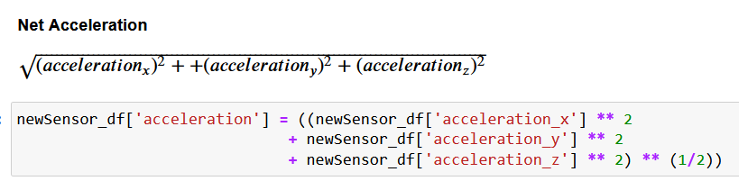
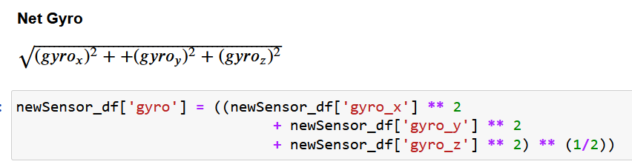
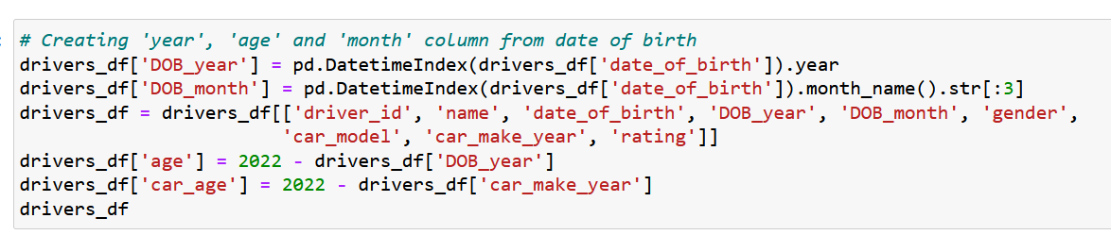
ETL – Feature Engineering
Magnitude of Acceleration & Gyro calculated as follows
Calculating age of driver and age of car

Slide 16
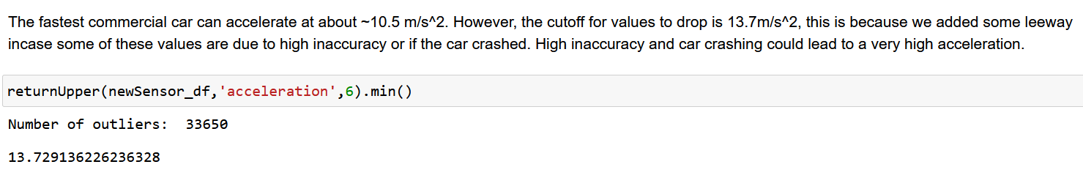
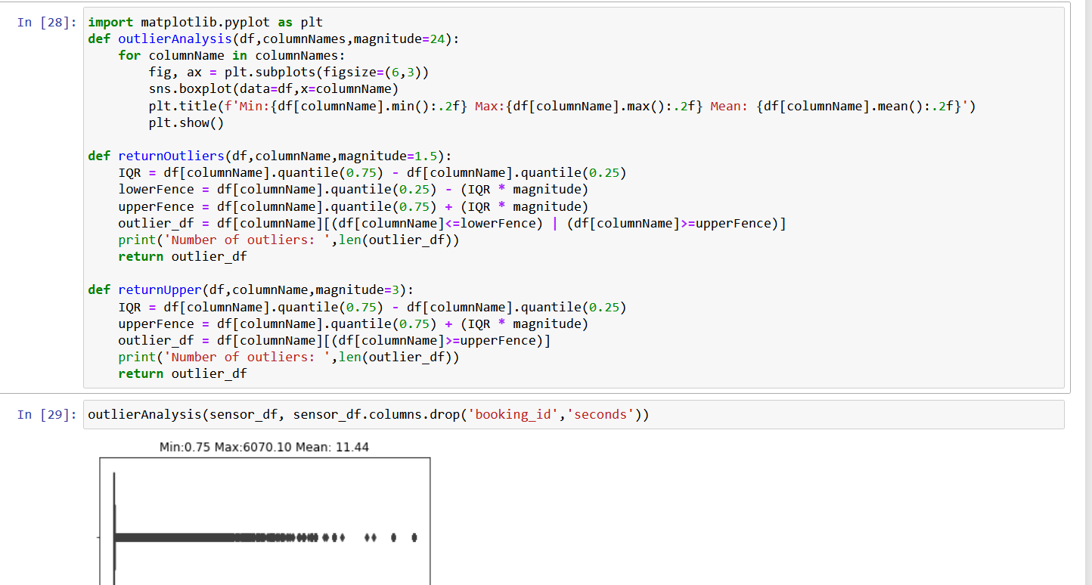
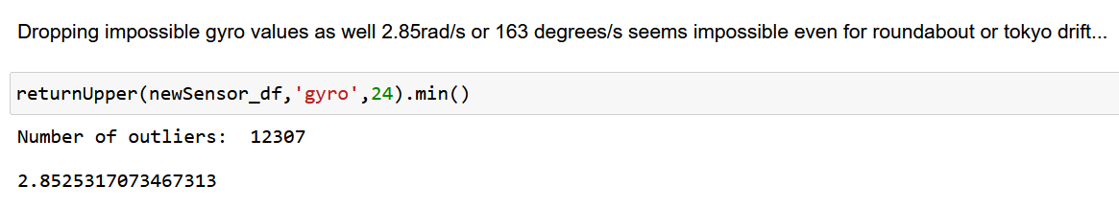
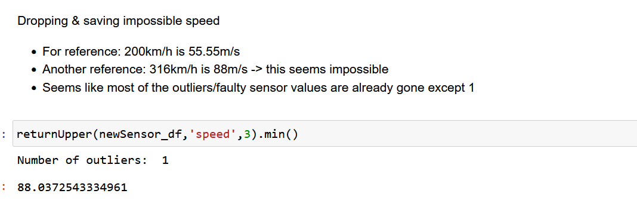
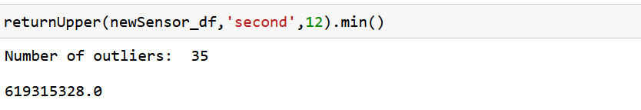
ETL – Removing & Saving Outliers
Remove outliers where Acceleration > 13.7m/s².
Functions to plot boxplot and return lower and upper fence outliers.
Remove outliers where Gyro > 2.85 rad/s
Remove outliers where Speed > 88m/s
Remove outliers where seconds > 619315328s
These outliers are still saved in a separate Dataframe.

Slide 17
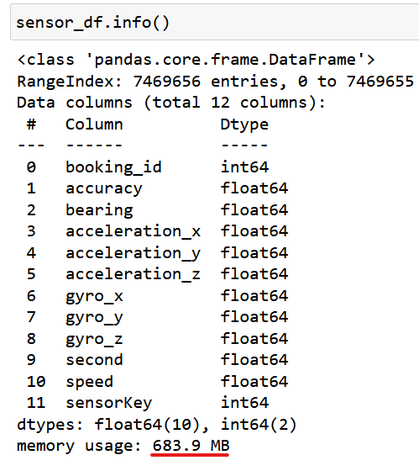
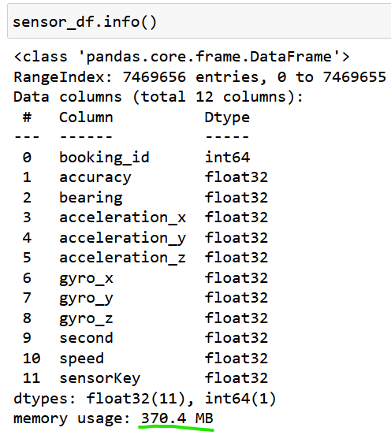
ETL – Optimizations
Change Floating Point
Loading our cleansed data in batches

Slide 18
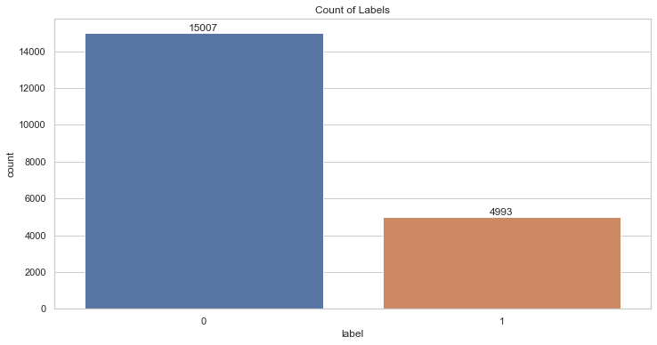
Exploratory Data Analysis
The total number of dangerous trips is 4,993
The total number of safe trips is 15,007.

Slide 19
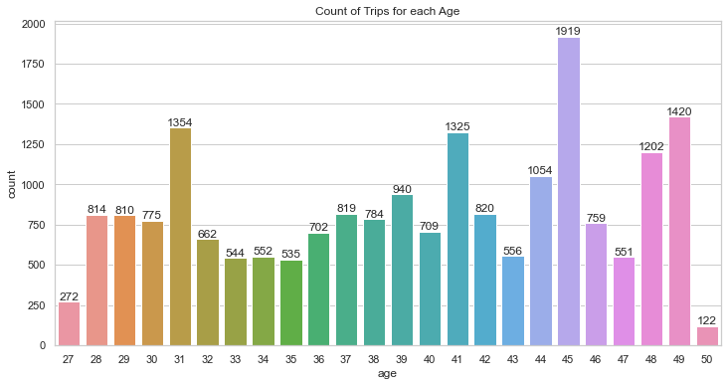
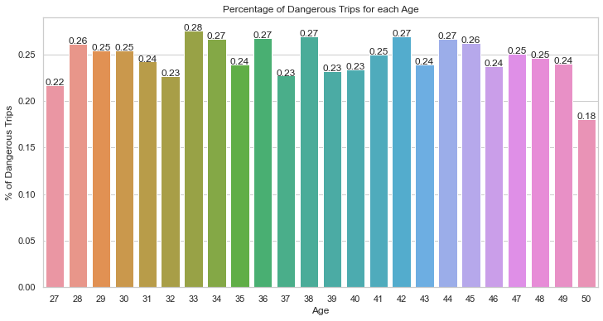

Exploratory Data Analysis
50 years old drivers has the lowest total number of trips made (122)
45 years old drivers have the highest total number of trips made (1,919)
Lowest % of dangerous trips made is 50 years old, (18%).
Highest % of dangerous trips is 33 years old (28%)

Slide 20
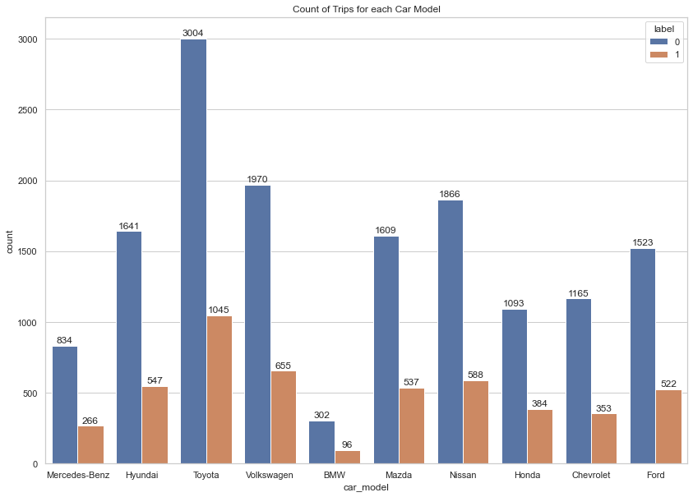
Exploratory Data Analysis
Toyota has the greatest number of trips, having a total of 3,004 safe trips and 1,045 dangerous trips.
BMW has the lowest smallest number of trips made, having a total of 302 safe trips and 96 dangerous trips.

Slide 21
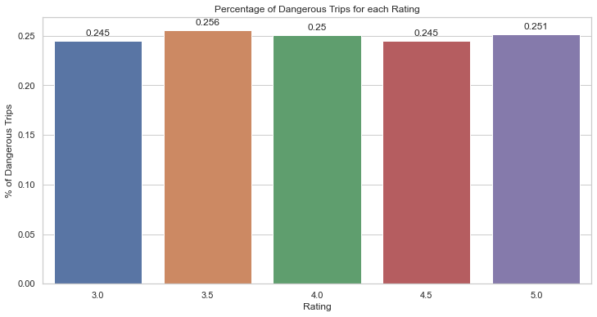
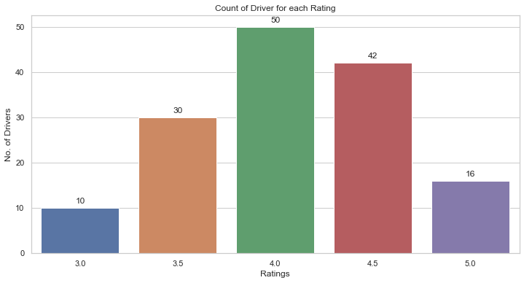
Exploratory Data Analysis
Car rating ranges from 3 to 5.
Most of the drivers (50) have a rating of 4.
With only 10 drivers having a lowest rating of 3 and 16 drivers having a highest rating of 5.
% of dangerous driving seem to be very similar across the different ratings.

Slide 22
Week 6-7 Deliveriables
Tableau sheets and dashboard

Slide 23
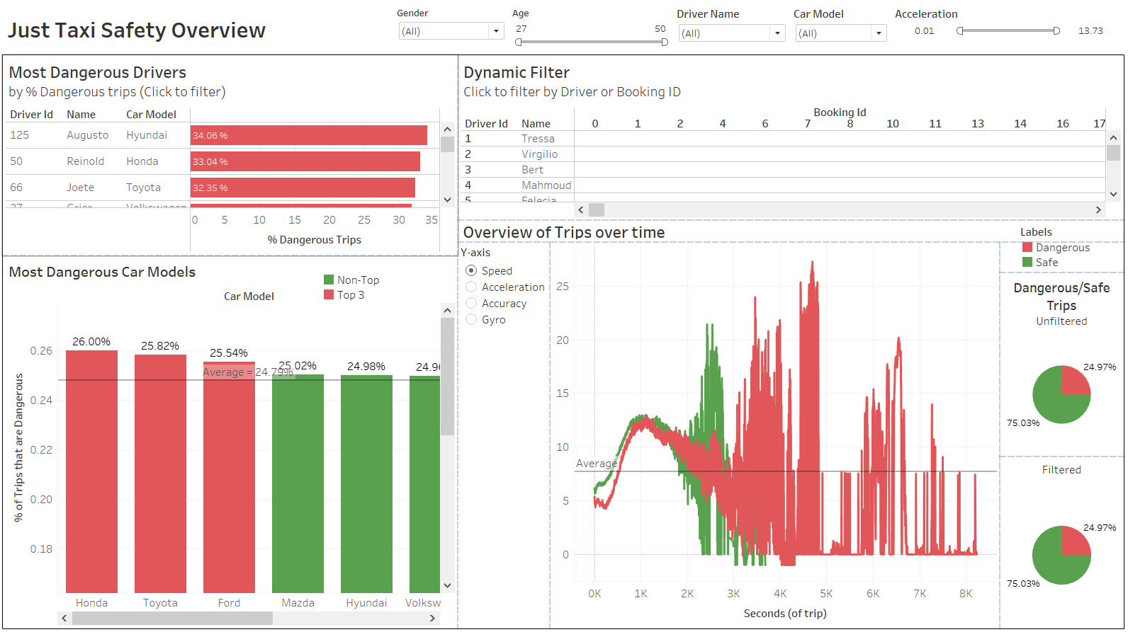
Dashboard
Focus of Dashboard:
Interactivity
Data density
Multi granularity visualization
Values presented are true (by using custom SQL data source)
Cater to our user needs. Useful for taxi drivers and managers

Slide 24

DASHBOARD LIVE DEMO!

Slide 25
Dashboard Insights 1
From Overview of Trips over time: (Speed)
Average speed in the ‘Dangerous’ trips are peaking higher than the safe trips
Driving behaviour between safe trips and dangerous trips is quite distinct

Slide 26
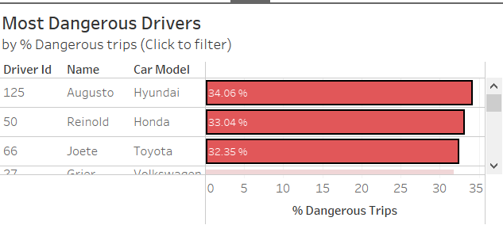
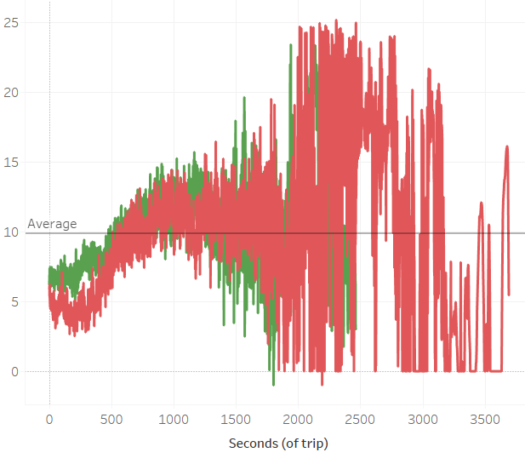
Dashboard Insights 2
From Overview of Trips over time: (Speed)
This time we filter by Top 3 most dangerous drivers
Difference in Driving behaviour between safe trips and dangerous trips is quite minimal
Filtering by top 3 most dangerous drivers (just click on them!)

Slide 27
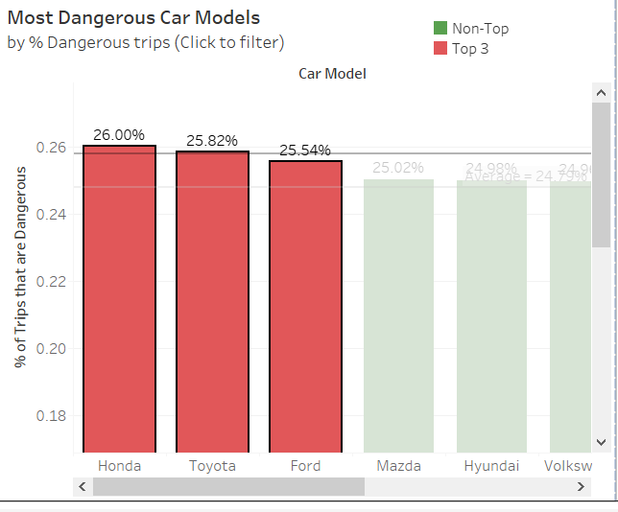
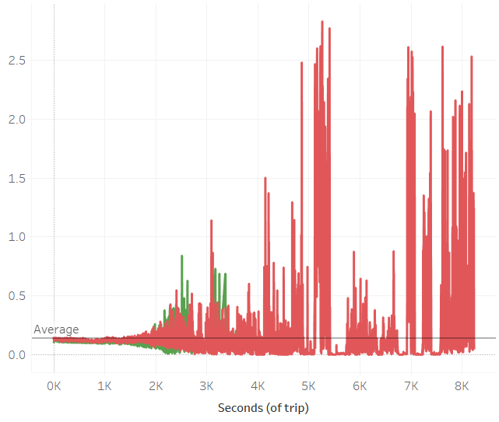
Dashboard Insights 3
From Overview of Trips over time: (Gyro)
This time we filter by Top 3 most dangerous car models (brands)
Magnitude of gyro much higher on average for dangerous trips
Drivers are rotating at fast rates, could lead to accidents!
Filtering by top 3 most dangerous car models (just click on them!)

Slide 28
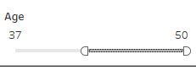
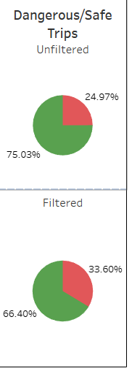
Dashboard Insights 4
When filtering for drivers aged 37-50
% of dangerous trips increased from 24.97% to 33.60% (almost 10%) !
This could mean that more senior drivers are driving more recklessly
Perhaps this is because younger drivers were more recently trained in driving school
Overtime, senior drivers become more comfortable and start to be more careless

Slide 29

Thank You For Listening!
Cool dashboard man, now I know how to improve myself
Look at how happy this taxi driver is!

